Slide 1
Name : A Chaithra Class : 7th Roll No : 2 Section : C

Slide 2
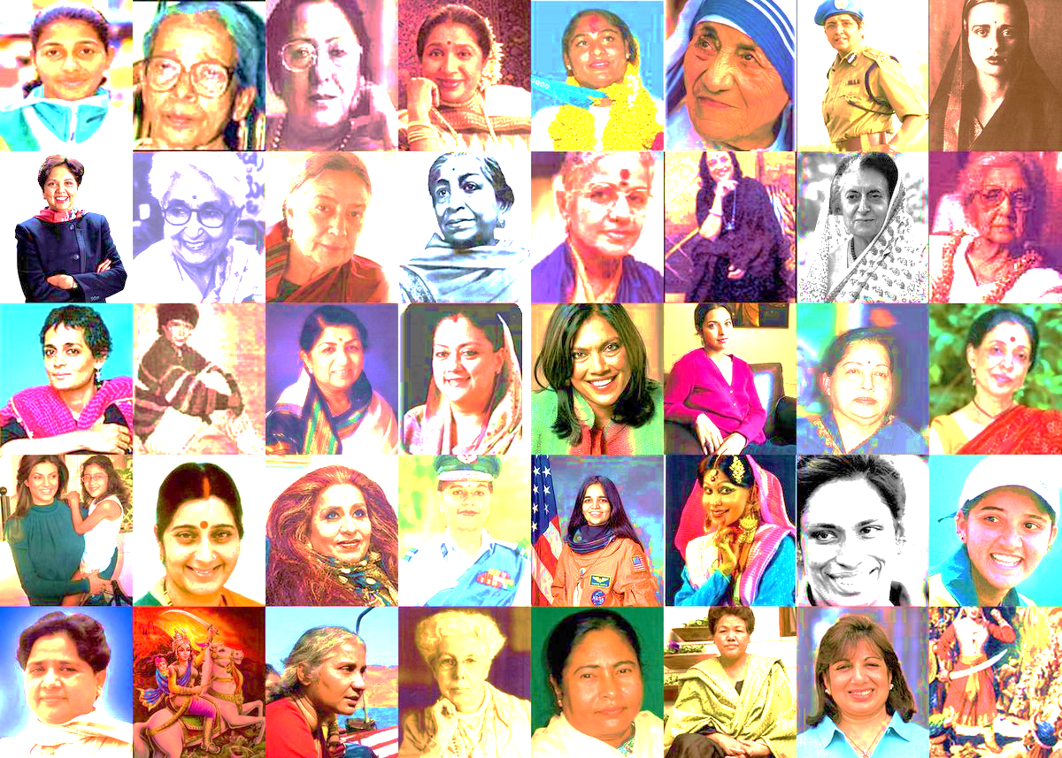
Women s Who Made INDIA Proud

Slide 3
Agenda
Indira Gandhi
Savitribai Phule
Mary Kom
Kiran Bedi
Gita Gopinath

Slide 4
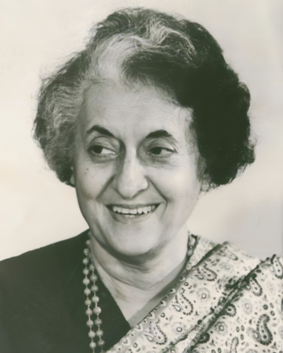
INDIRA GANDHI
Indira Priyadarshini Gandhi Nehru; 19 November 1917 – 31 October 1984) was an Indian politician and stateswoman who served as the Prime Minister of India from 1966 to 1977 and again from 1980 until her assassination in 1984. She was India's first and, to date, only female prime minister, and a central figure in Indian politics as the leader of the Indian National Congress (INC). She was the daughter of Jawaharlal Nehru, the first prime minister of India, and the mother of Rajiv Gandhi, who succeeded her in office as the country's sixth prime minister. Gandhi's cumulative tenure of 15 years and 350 days makes her the second-longest-serving Indian prime minister after her father. Henry Kissinger described her as an "Iron Lady", a nickname that became associated with her tough personality.
During Nehru's premiership from 1947 to 1964, Gandhi was his hostess and accompanied him on his numerous foreign trips. In 1959, she played a part in the dissolution of the communist-led Kerala state government as then-president of the Indian National Congress, otherwise a ceremonial position to which she was elected earlier that year. Lal Bahadur Shastri, who had succeeded Nehru as prime minister upon his death in 1964, appointed her minister of information and broadcasting in his government; the same year she was elected to the Rajya Sabha, the upper house of the Indian Parliament. After Shastri's sudden death in January 1966, Gandhi defeated her rival, Morarji Desai, in the INC's parliamentary leadership election to become leader and also succeeded Shastri as prime minister. She led the Congress to victory in two subsequent elections, starting with the 1967 general election, in which she was first elected to the lower house of the Indian parliament, the Lok Sabha. In 1971, her party secured its first landslide victory since her father's sweep in 1962, focusing on issues such as poverty. But following the nationwide state of emergency she implemented, she faced massive anti-incumbency sentiment causing the INC to lose the 1977 election, the first time in the history of India to happen so. She even lost her own parliamentary constituency. However, due to her portrayal as a strong leader and the weak governance of the Janata Party, her party won the next election by landslide with her return to the premiership.
Prime Minister of India
1966–1977 1980–1984

Slide 5
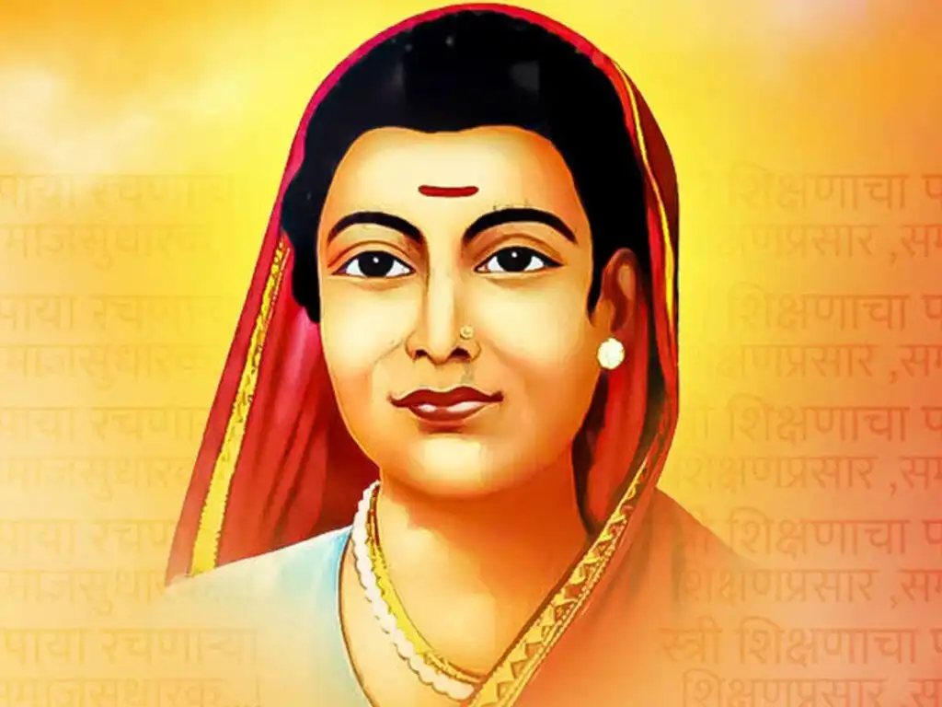
SAVITRIBAI PHULE
Savitribai Phule was one of the first female teachers in India a social reformer, and a poet. Along with her husband, Jyotiba Phule, in Maharashtra, she played a vital role in improving women's rights in India. She is considered to be the pioneer of India's feminist movement. She strived to abolish discrimination and unfair treatment of people based on caste and gender. She and her husband were pioneers of women's education in India They started their first school for girls in 1848 in Pune at Tatyasaheb Bhide's residence or Bhidewada.
1831- 1897

Slide 6
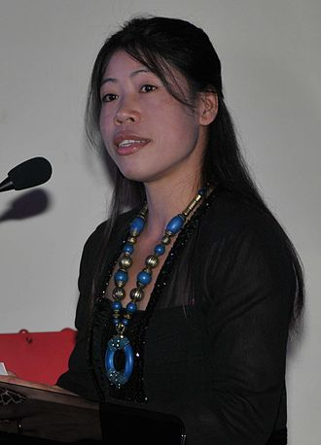
MARY KOM
Mangte Chungneijang "Mary" Kom (born 24 November 1982) is an Indian Olympic boxer, politician, and former Member of Rajya Sabha. She is the only woman to win the World Amateur Boxing Championship six times, the only female boxer to have won a medal in each one of the first seven World Championships, and the only boxer (male or female) to win eight World Championship medals. Nicknamed Magnificent Mary, she was the only Indian female boxer to have qualified for the 2012 Summer Olympics, where she competed in the flyweight (51 kg) category and won a bronze medal. She had also been ranked as the world's No. 1 female light-flyweight by the International Boxing Association (amateur) (AIBA). She became the first Indian female boxer to win a gold medal in the Asian Games in 2014 at Incheon, South Korea and is the first Indian female boxer to win gold at the 2018 Commonwealth Games.[13] She is also the only boxer to become Asian Amateur Boxing Champion for a record six times.[14][15] Mary Kom won the 51kg gold in President's Cup in Indonesia.
Member of Parliament, Rajya Sabha
In office 25 April 2016 – 24 April 2022

Slide 7
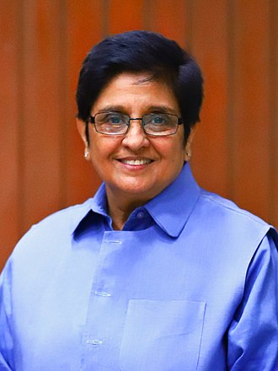
KIRAN BEDI
Kiran Bedi PPMG PNBB (born 9 June 1949) is a former tennis player who became the first woman in India to join the officer ranks of the Indian Police Service (IPS) in 1972 and was the 24th Lieutenant Governor of Puducherry from 28 May 2016 to 16 February 2021.She remained in service for 35 years before taking voluntary retirement in 2007 as Director General, Bureau of Police Research and Development.
As a teenager, Bedi was crowned the national junior tennis champion in 1966. Between 1965 and 1978, she won several titles at various national and state-level championships. After joining the IPS, Bedi served in Delhi, Goa, Chandigarh and Mizoram. She started her career as an Assistant Superintendent of Police (ASP) in the Chanakyapuri area of Delhi, and won the President's Police Medal in 1979. Next, she moved to West Delhi, where she brought about a reduction in crimes against women. Subsequently, as a traffic police officer, she oversaw traffic arrangements for the 1982 Asian Games in Delhi and the Commonwealth Heads of Government Meeting 1983 in Goa. As Deputy Commissioner of Police of North Delhi, she launched a campaign against drug abuse, which evolved into the Navjyoti Delhi Police Foundation (renamed to Navjyoti India Foundation in 2007).
1831- 1897
24th Lieutenant Governor of Pondicherry
In office 28 May 2016 – 16 February 2021

Slide 8
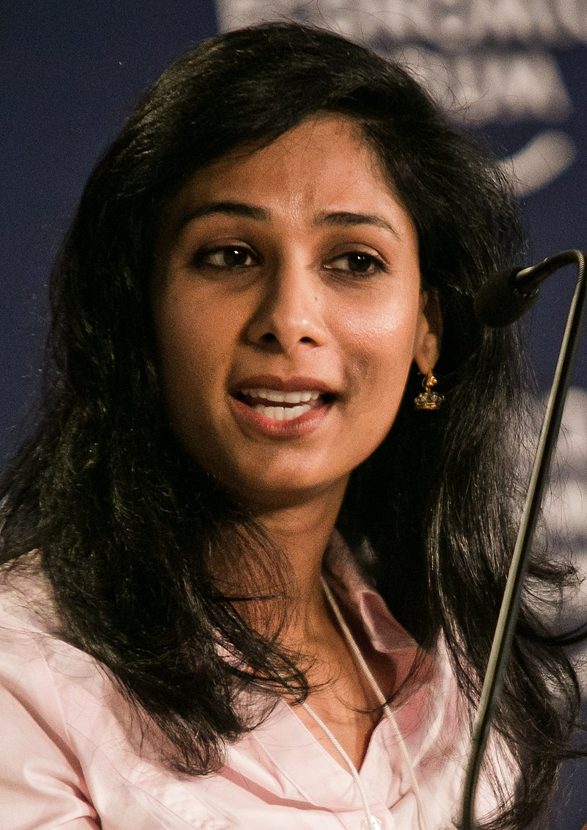
GITA GOPINATH
Gita Gopinath (born 8 December 1971) is an Indian-American economist who has served as the first deputy managing director of the International Monetary Fund (IMF), since 21 January 2022. She had previously served as chief economist of the IMF between 2019 and 2022.
Prior to joining the IMF, Gopinath had a two-decade-long career as an academic including at the economics department of Harvard University where she was the John Zwaanstra Professor of International Studies and Economics (2005–2022) and earlier an assistant professor at the University of Chicago Booth School of Business (2001–05) . She is also a co-director of the international finance and macroeconomics program at the National Bureau of Economic Research and has earlier worked as the honorary economic adviser to the chief minister of Kerala.
Gopinath was appointed as chief economist of the IMF in October 2018 by its managing director Christine Lagarde. In an interview with Trevor Noah on The Daily Show, she named the worldwide recession of 2020 as "The Great Lockdown". In December 2021, IMF Managing Director Kristalina Georgieva appointed her the first deputy managing director of the IMF, which is the organization's number-two position.
First Deputy Managing Director of the International Monetary Fund
Incumbent
Assumed office 21 January 2022

